Slide 1

One Way ANova
With example
Prepared by Chea Makara

Slide 2
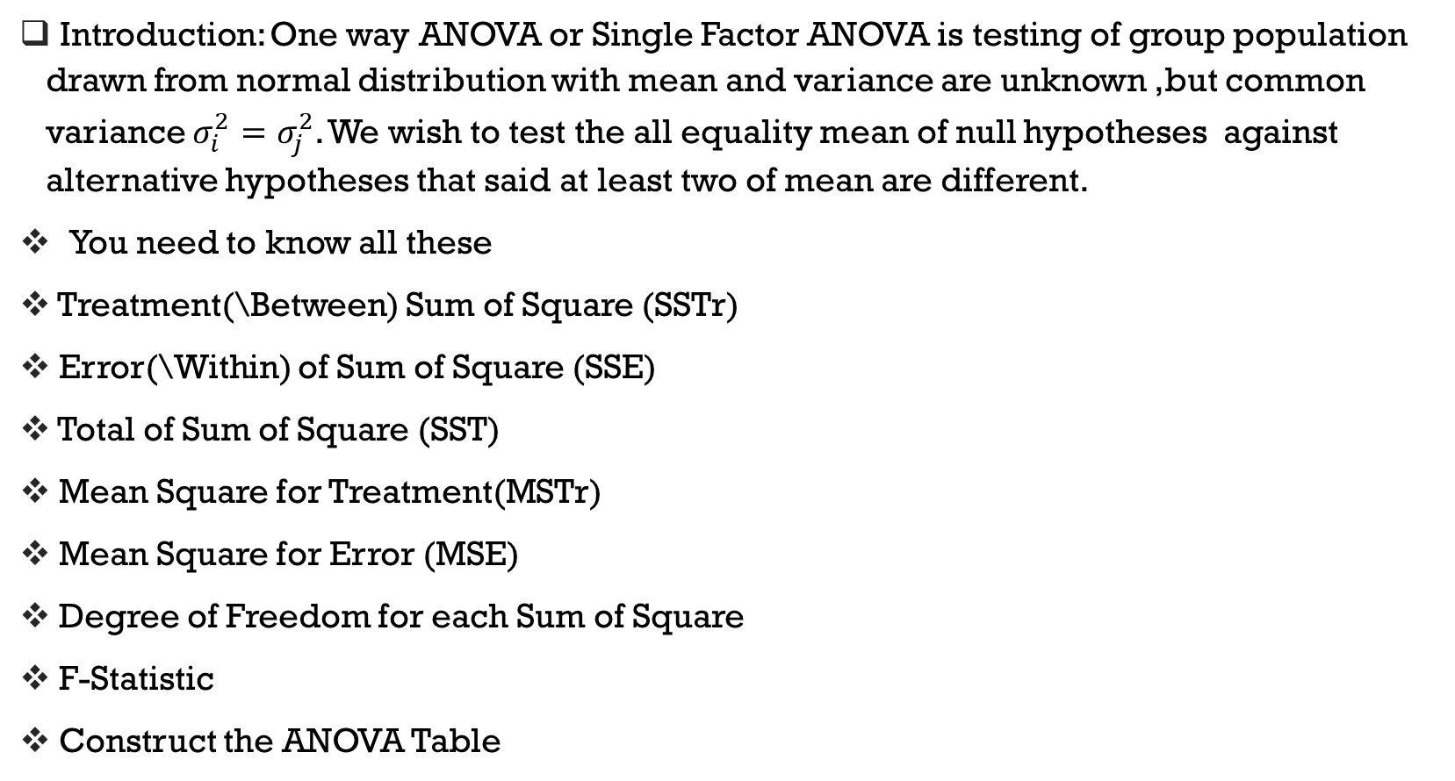
Introduction: One way ANOVA or Single Factor ANOVA is testing of group population drawn from normal distribution with mean and variance are unknown ,but common variance $σ_{i}^{2}=σ_{j}^{2}$. We wish to test the all equality mean of null hypotheses against alternative hypotheses that said at least two of mean are different.
You need to know all these
Treatment(\Between) Sum of Square (SSTr)
Error(\Within) of Sum of Square (SSE)
Total of Sum of Square (SST)
Mean Square for Treatment(MSTr)
Mean Square for Error (MSE)
Degree of Freedom for each Sum of Square
F-Statistic
Construct the ANOVA Table

Slide 3
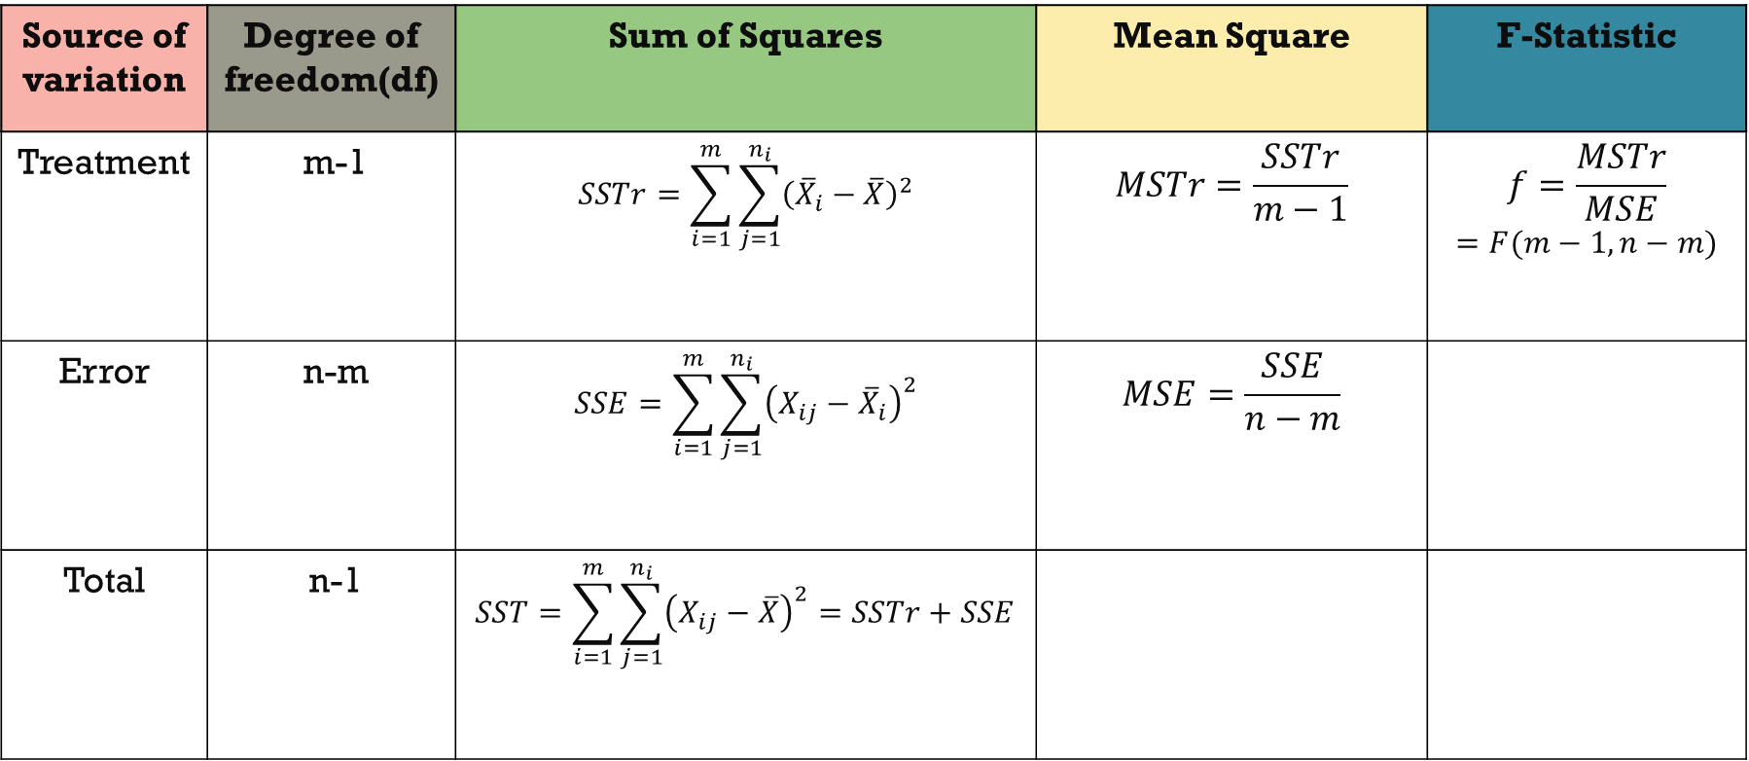
ANOVA table summarize
Source of variation | Degree of freedom(df) | Sum of Squares | Mean Square | F-Statistic
Treatment | m-1 | $$SSTr=\sum_{i=1}^{m}{\sum_{j=1}^{n_{i}}{{\left({\overline{X}}_{i}−\overline{X}\right)}^{2}}}$$ | $$MSTr=\frac{SSTr}{m−1}$$ | $$f=\frac{MSTr}{MSE}$$ $$=F(m−1,n−m)$$
Error | n-m | $$SSE=\sum_{i=1}^{m}{\sum_{j=1}^{n_{i}}{{\left(X_{ij}−{\overline{X}}_{i}\right)}^{2}}}$$ | $$MSE=\frac{SSE}{n−m}$$
Total | n-1 | $$SST=\sum_{i=1}^{m}{\sum_{j=1}^{n_{i}}{{\left(X_{ij}−\overline{X}\right)}^{2}}=SSTr+SSE}$$

Slide 4
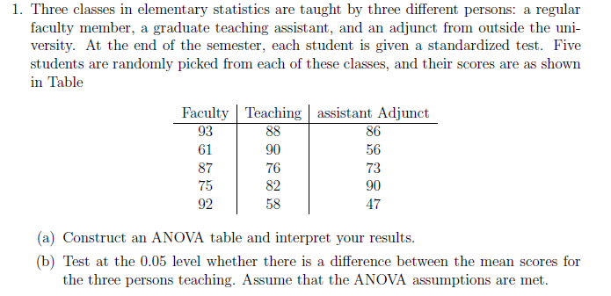

Slide 5
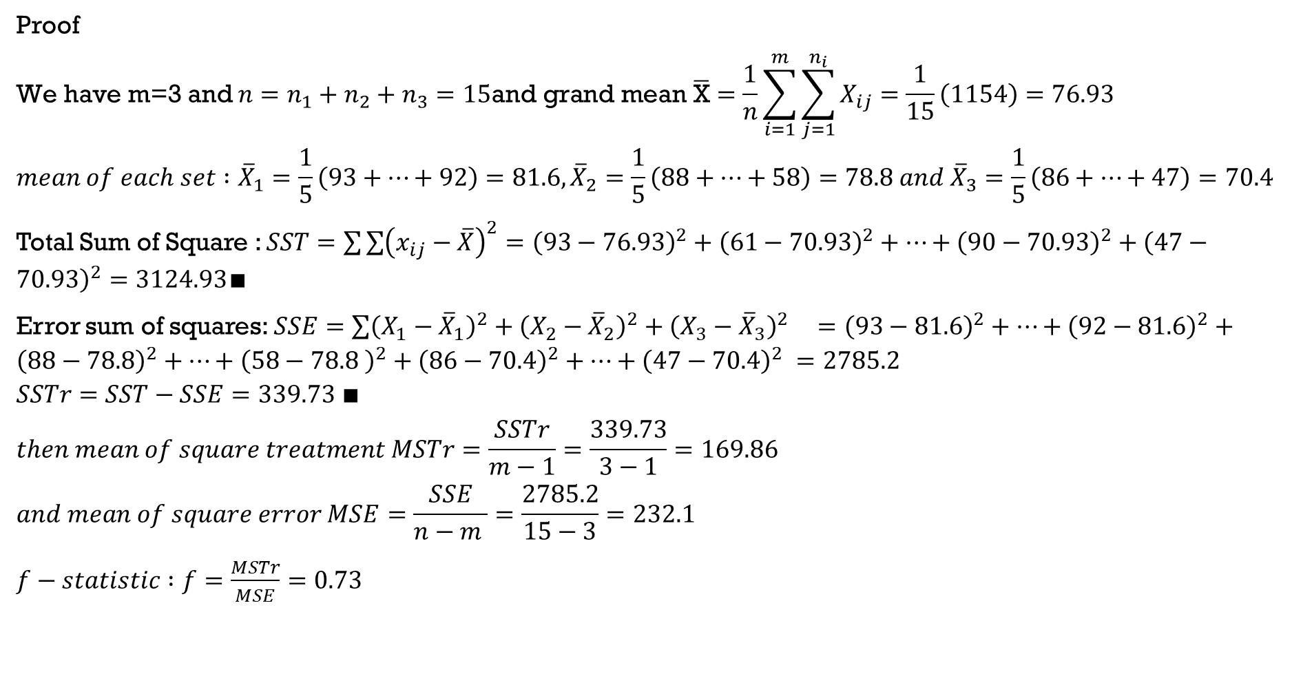
Proof
$$\text{We} \text{have} \text{m}\text{=3 }\text{and} n=n_{1}+n_{2}+n_{3}=15\text{and} \text{grand} \text{mean} \overline{\text{X}}=\frac{1}{n}\sum_{i=1}^{m}{\sum_{j=1}^{n_{i}}{X_{ij}}}=\frac{1}{15}\left(1154\right)=76.93$$
$$mean of each set :{\overline{X}}_{1}=\frac{1}{5}\left(93+…+92\right)=81.6, {\overline{X}}_{2}=\frac{1}{5}\left(88+…+58\right)=78.8 and {\overline{X}}_{3}=\frac{1}{5}\left(86+…+47\right)=70.4$$
Total Sum of Square : $SST=\sum{\sum{{\left(x_{ij}−\overline{X}\right)}^{2}}={\left(93−76.93\right)}^{2}+{\left(61−70.93\right)}^{2}+…+{\left(90−70.93\right)}^{2}+{\left(47−70.93\right)}^{2}}=3124.93∎$
Error sum of squares: $SSE=\sum{{\left(X_{1}−{\overline{X}}_{1}\right)}^{2}+{\left(X_{2}−{\overline{X}}_{2}\right)}^{2}+{\left(X_{3}−{\overline{X}}_{3}\right)}^{2 } }={\left(93−81.6\right)}^{2}+…+{\left(92−81.6\right)}^{2}+{\left(88−78.8\right)}^{2}+…+{\left(58−78.8 \right)}^{2}+{\left(86−70.4\right)}^{2}+…+{\left(47−70.4\right)}^{2} =2785.2$
$$SSTr=SST−SSE=339.73 ∎$$
$$then mean of square treatment MSTr=\frac{SSTr}{m−1}=\frac{339.73}{3−1}=169.86$$
$$and mean of square error MSE=\frac{SSE}{n−m }=\frac{2785.2}{15−3}=232.1$$
$f−statistic :f=\frac{MSTr}{MSE}=0.73$

Slide 6
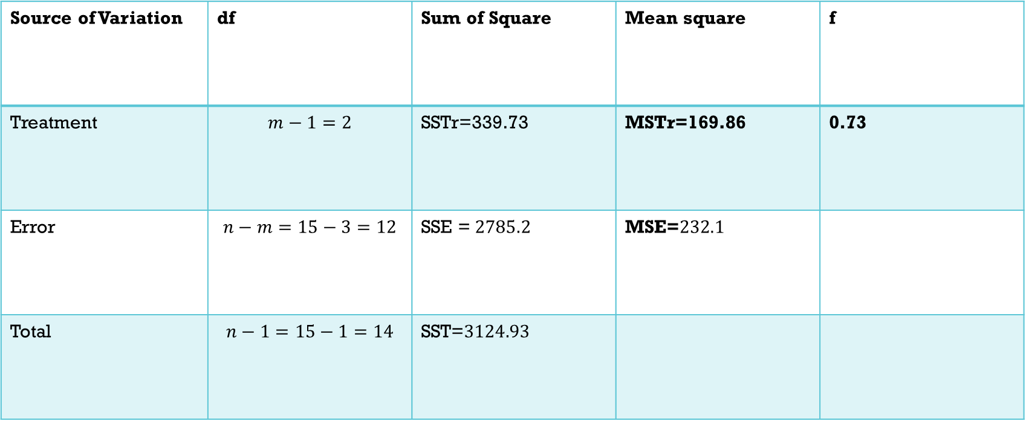
ANOVA table
Source of Variation | df | Sum of Square | Mean square | f
Treatment | $$m−1=2$$ | SSTr=339.73 | MSTr=169.86 | 0.73
Error | $$n−m=15−3=12$$ | SSE = $2785.2$ | MSE=$232.1$
Total | $$n−1=15−1=14$$ | SST=$3124.93$

Slide 7
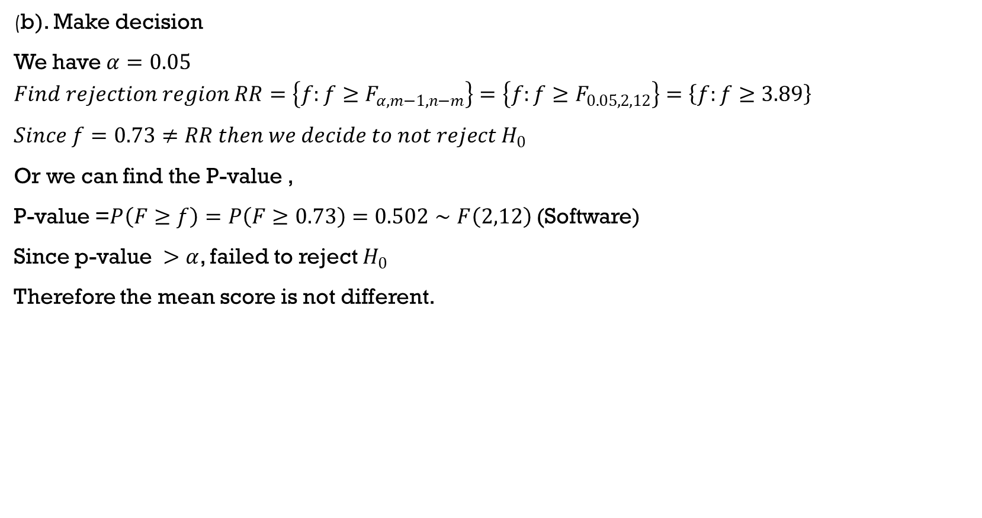
(b). Make decision
We have $α=0.05$
$$Find rejection region RR=\left\{f:f≥F_{α,m−1,n−m}\right\}=\left\{f:f≥F_{0.05,2,12}\right\}=\left\{f:f≥3.89\right\}$$
$Since f=0.73≠RR then we decide to not reject H_{0}$
Or we can find the P-value ,
P-value =$P\left(F≥f\right)=P\left(F≥0.73\right)=0.502∼F\left(2,12\right)$(Software)
Since p-value $>α$, failed to reject $H_{0}$
Therefore the mean score is not different.

